Slide 1
Lagrange multiplier & Taylor formula
Department of Mathematics PSG College of Technology

Slide 2
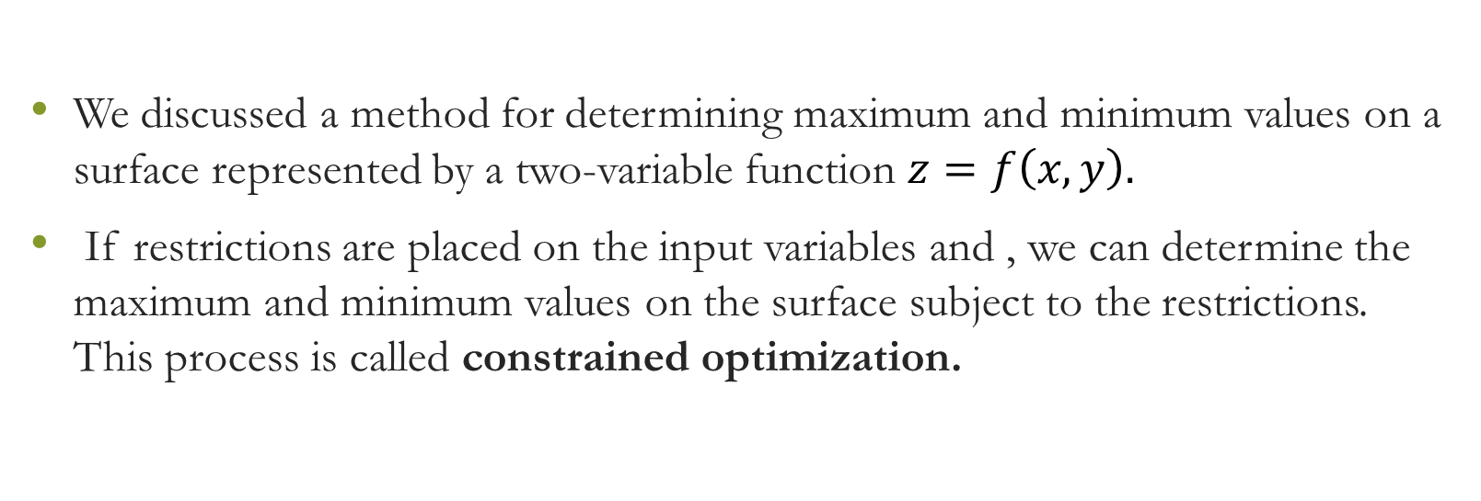
Introduction
We discussed a method for determining maximum and minimum values on a surface represented by a two-variable function $z=f\left(x,y\right).$
If restrictions are placed on the input variables and , we can determine the maximum and minimum values on the surface subject to the restrictions. This process is called constrained optimization.

Slide 3
Introduction
To find the extreme values of a function whose domain is constrained to lie within some particular subset of the plane—For example, a disk, a closed triangular region, or along a curve.
Here we explore a powerful method for finding extreme values of constrained functions: the method of Lagrange multipliers.

Slide 4
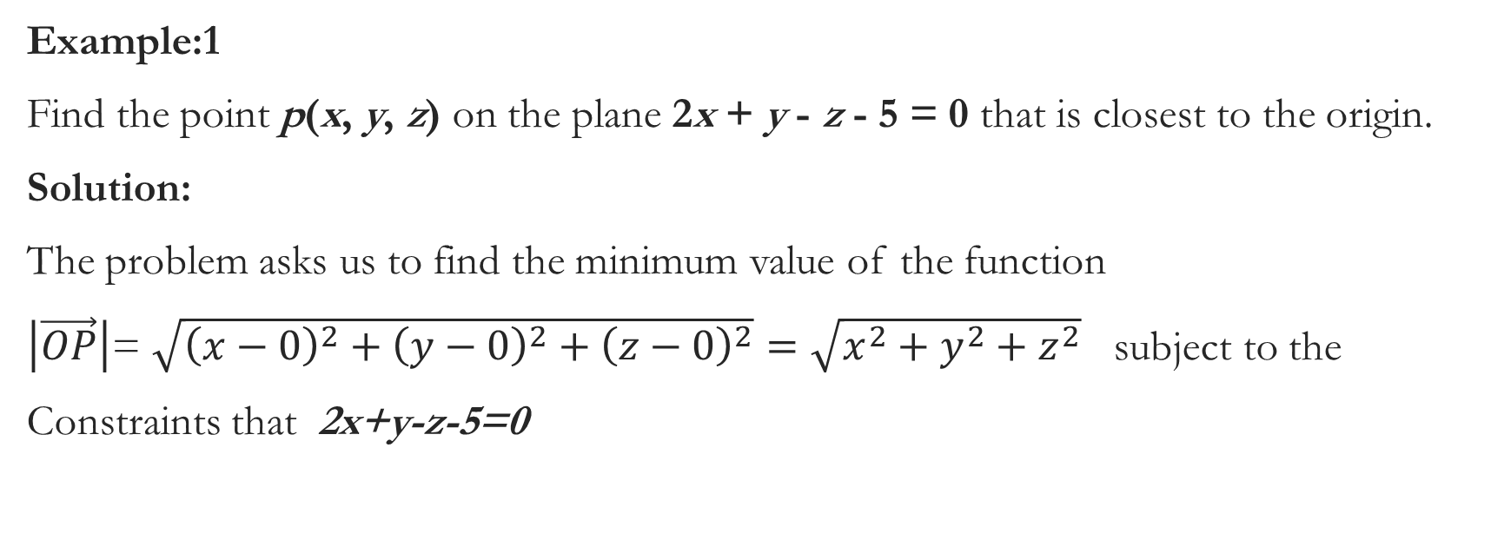
We first consider a problem where a constrained minimum can be find by eliminating a variable.
Example:1
Find the point p(x, y, z) on the plane 2x + y - z - 5 = 0 that is closest to the origin.
Solution:
The problem asks us to find the minimum value of the function
$\left|\vec{OP}\right|$= $\sqrt{{\left(x−0\right)}^{2}+{\left(y−0\right)}^{2}+{\left(z−0\right)}^{2}}=\sqrt{x^{2}+y^{2}+z^{2}}$ subject to the
Constraints that 2x+y-z-5=0

Slide 5
Example:1

Slide 6
Example:1

Slide 7
Example:1

Slide 8
Note
Note:
Solving a constrained maximum or minimum problem by substitution, as we might call the method of Example 1, do not always go smoothly.

Slide 9
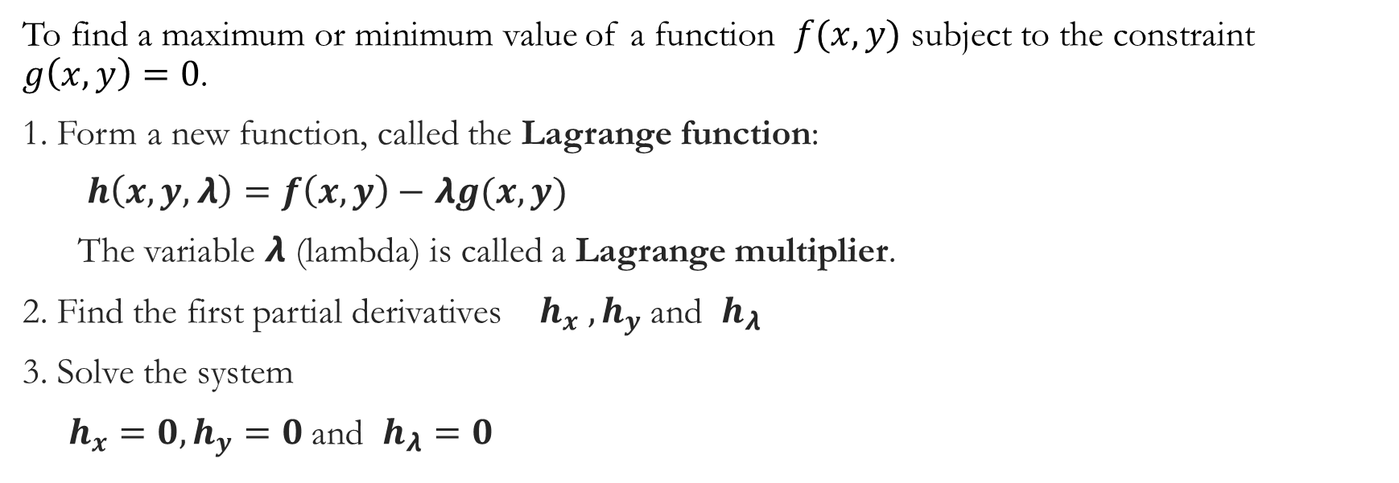
The Method of Lagrange Multipliers (for two variables)
To find a maximum or minimum value of a function $f(x,y)$ subject to the constraint $g\left(x,y\right)=0$.
1. Form a new function, called the Lagrange function:
$h\left(x,y,λ\right)=f\left(x,y\right)−λg(x,y)$
The variable $λ$ (lambda) is called a Lagrange multiplier.
2. Find the first partial derivatives $h_{x} ,h_{y}$and $h_{λ}$
3. Solve the system
$h_{x}=0,h_{y}=0$and $h_{λ}=0$

Slide 10
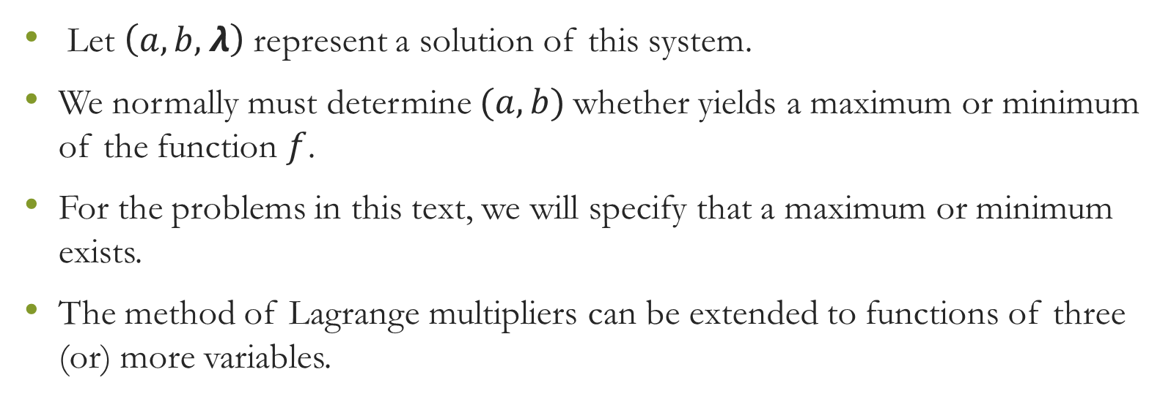
Lagrange Multipliers
Let $\left(a,b,λ\right)$represent a solution of this system.
We normally must determine $(a,b)$whether yields a maximum or minimum of the function $f$.
For the problems in this text, we will specify that a maximum or minimum exists.
The method of Lagrange multipliers can be extended to functions of three (or) more variables.

Slide 11
The Method of Lagrange Multipliers (for three variables)

Slide 12
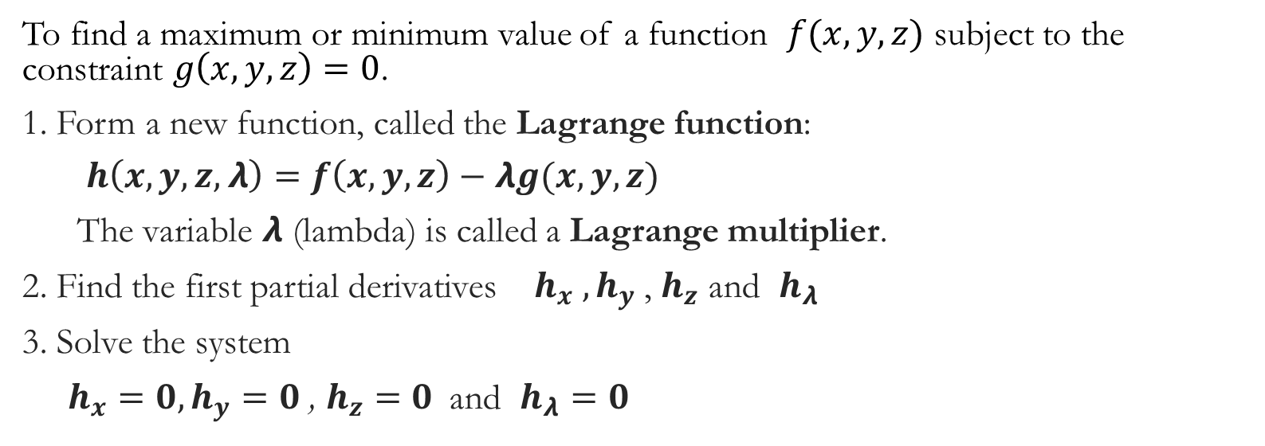
The Method of Lagrange Multipliers (for three variables)
To find a maximum or minimum value of a function $f(x,y,z)$ subject to the constraint $g\left(x,y,z\right)=0$.
1. Form a new function, called the Lagrange function:
$h\left(x,y,z,λ\right)=f\left(x,y,z\right)−λg(x,y,z)$
The variable $λ$ (lambda) is called a Lagrange multiplier.
2. Find the first partial derivatives $h_{x} ,h_{y}$, $h_{z}$ and $h_{λ}$
3. Solve the system
$h_{x}=0,h_{y}=0$, $h_{z}=0$and $h_{λ}=0$

Slide 13
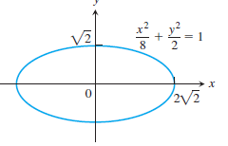

Example:3
Example : 3
Find the smallest and greatest values of the function $f\left(x,y\right)=xy$ takes on the ellipse $\frac{x^{2}}{8}+\frac{y^{2}}{2}=1.$

Slide 14
Example:3

Slide 15
Example:3
.

Slide 16
Geometry of the Solution

Slide 17

Example:4
Find the maximum and minimum values of the function $f\left(x,y\right)=3x+4y$ on the circle $x^{2}+y^{2}=1$.

Slide 18
Example:4

Slide 19
Example:4

Slide 20
Example:4

Slide 21
Geometry of the Solution

Slide 22
Taylor’s Formula for Two Variables

Slide 23

Taylor’s formula for $f(x,y)$at the Origin

Slide 24
Note
The first n derivative terms are evaluated at (0, 0). The last term is evaluated at a point on the line segment joining the origin and (x, y).
Taylor’s formula provides polynomial approximations of two-variable functions.
The first n derivative terms give the polynomial; the last term gives the approximation error.
The first three terms of Taylor’s formula give the function’s linearization.
To improve on the linearization, we add higher-power terms.

Slide 25
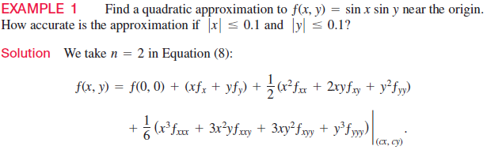
Example 1

Slide 26
Example 1

Slide 27
Example 1

Slide 28
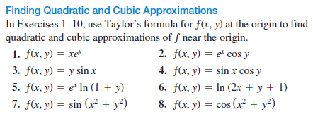
Exercises

